Slide 1
January 2024
Anna Jester & Rachel Taylor
Co-Chairs, CSE Connect

Slide 2
2024 Annual Meeting
CouncilScienceEditors.org
Notes:
The big event every year is CSE’s annual meeting with the last one held in Toronto, Here is information about the next meeting and we hope you are able to come!

Slide 3
CSE CONNECT
January – Poster Submission 101
Previous topics:
June 2023 – Meet the Committees of CSE Happy Hour
September 2023 – What do I need to know before I start contracting?
October 2023 – CSE Book Club: Data Story: Explaining Data and Inspire Action Through Story by Nancy Duarte
November 2023 - What Your Editorial System Manager Wishes You Knew: How to problem solve faster
December 2023 - The Financial Wellbeing of CSE: An Update from CSE’s Finance Committee
CouncilScienceEditors.org
Notes:
CSE Connect. Launched during the pandemic, these are low-key events, featuring a speaker or two on a specific topic, with plenty of time for Q&A. Here is a list of some of our recent connections.

Slide 4
POSTER SUBMISSION 101
Guests:
Alice Ellingham, Director, Editorial Office Ltd
Shari Leventhal, Executive Editor, ASN Alliance for Kidney Health
CouncilScienceEditors.org

Slide 5
POSTER SUBMISSION 101
General Information on How to Submit an Educational Poster to CSE:
When: Due Date: Notifications and acceptance will be reviewed on a rolling basis and all decisions sent by March 15, 2024
What: Clearly explain each section so that the reader understands the use case and why this topic is important.
How: Submit a google form with the following information:
Submitting Author
Submitting Author email address
Author names and employers
Author disclosures
Introduction (Purpose of the study/poster) (50 words)
Background results/findings (150 words)
Conclusions/summary (50 words)
Additional Details:
CSE will provide a template to use.
There will be a $50 administrative fee assessed per poster, following acceptance notification.
CouncilScienceEditors.org

Slide 6
POSTER SUBMISSION 101
“I am currently a member of staff at a journal, so the poster submission process was a great way for me to learn about the review process from the other side of the process. The reviews were very useful to help reconsider some of the statistics we used and, in addressing some of the comments we received, I learned additional skills in statistical analysis and data visualization. In addition, my poster at the Peer Review Congress was the first poster presentation I had given, so I also developed skills in concisely explaining the study to people unfamiliar with the journal.” Emma Smith
Journal Development Editor, eLife
CouncilScienceEditors.org

Slide 7
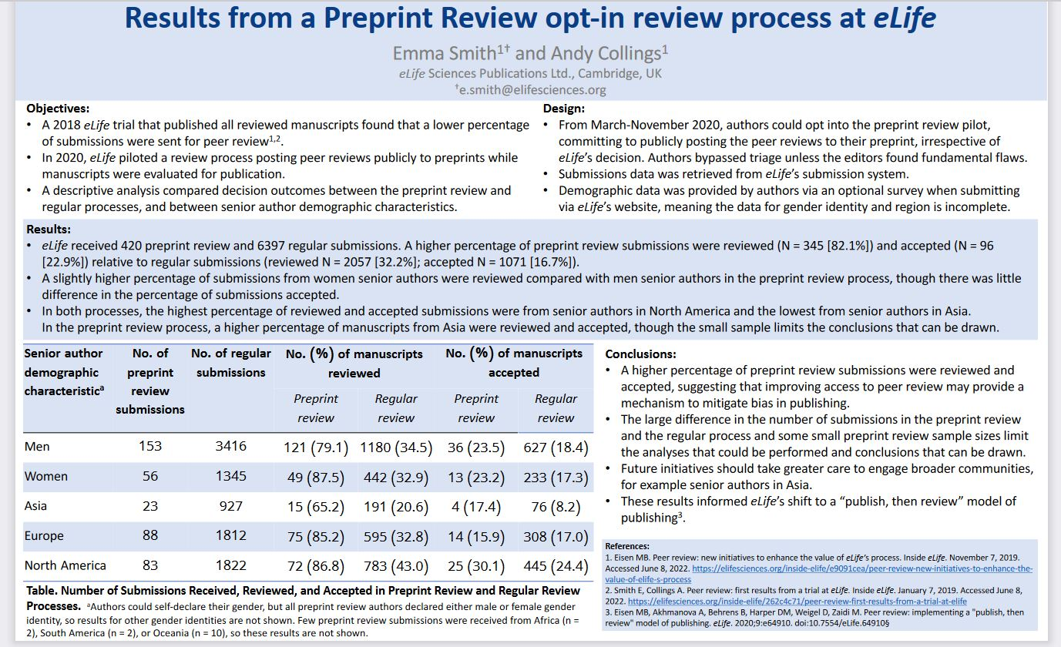
POSTER SUBMISSION 101
CouncilScienceEditors.org

Slide 8
CSE CONNECT
Have you presented a poster at a meeting before? Describe your experience.
CouncilScienceEditors.org

Slide 9
CSE CONNECT
What questions do you have about how to submit a poster?
CouncilScienceEditors.org

Slide 10
CSE Certificate Program
Already have an idea for a research project to submit as a poster? Use it to earn your CSE certificate!
Designed to provide professional development to editorial professionals
Consists of attending two CSE conferences, two CSE short Courses, three CSE webinars, and a research project
The research project can be an article, talk, presentation, or poster. We encourage participants to present their posters at the CSE annual meeting
For more information, contact msorenson@neurology.org
CouncilScienceEditors.org

Slide 11
Thank you for attending!
CouncilScienceEditors.org

